Slide 1
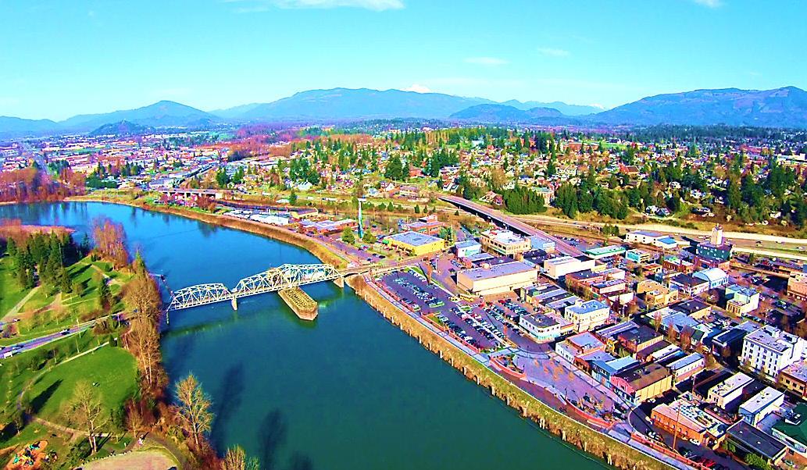


Development Services
Downtown Association
10/01/2025

Slide 2
Presentation Agenda
II. Periodic Update of the Comprehensive Plan
III. Downtown Waterfront EIS/Planned Action Ordinance
I. Introduction
IV. Q&A

Slide 3

I. Introduction and Purpose
Development Services Department
Community groups and public participation: consultation

Slide 4
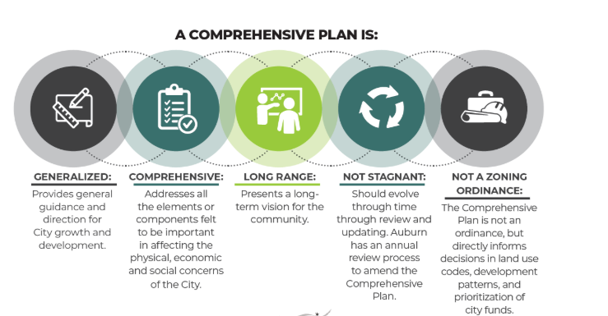

Slide 5
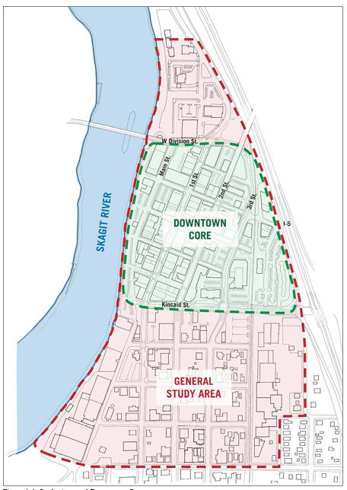
Approximately 2-year contract to complete an Environmental Impact Statement (EIS) and Planned Action Ordinance.
An economic development package to ease permitting for downtown projects and redevelopment.

Slide 6
IV. Q&A

Slide 7
Development Services
Downtown Association
10/1/2025

