Slide 1

Periodic Update of the Comprehensive Plan (2025-2045)
910 Cleveland Avenue
Mount Vernon, WA 98273
(360)-336-6214
www.mountvernonwa.gov
October 20, 2025

Slide 2

Comprehensive Plans
Growth Management Act (GMA) is a statewide planning framework
Establishes vision
Guides growth and development
Manage threats to quality of life
Provides direction for rules and regulations
Learn More:
Dept. of Commerce Background Materials: https://www.commerce.wa.gov/growth-management/education-outreach/advancing-meaningful-engagement-grants/
Graphic: inspiring.team, Adobe Stock
Notes:
First, I want to provide a little baseline information on local comprehensive plans, which are updated every ten years per the Growth Management Act.
The Growth Management Act (GMA) guides planning for growth and development in Washington State and grew out of statewide concern about rapid development and growth that was occurring, which was leading to sprawl and losses of resource lands and natural areas and was creating challenges for communities to fund infrastructure improvements from this type of uncoordinated development. GMA requires local governments in fast-growing and densely populated areas to develop and adopt comprehensive plans and development regulations that implement the comprehensive plan to guide future development and growth.
A comprehensive plan is a policy document that provides a "road map" to the community's vision for the next 20 years and helps guide how a jurisdiction will grow, look, and operate. The Comprehensive Plan guides decisions on where to build new jobs and houses, how to improve the transportation system, and where to make capital investments such as utilities, sidewalks, and community facilities. The Comprehensive Plan provides a future vision for a community and the tools needed to guide a community’s big-picture decisions on how to grow while maintaining or improving the quality of life.
Commerce has a number of resources available to you to learn more about the Growth Management Act and comprehensive plans developed under this Act. We have provided links to resources available on the Commerce website that provides information on the GMA.

Slide 3
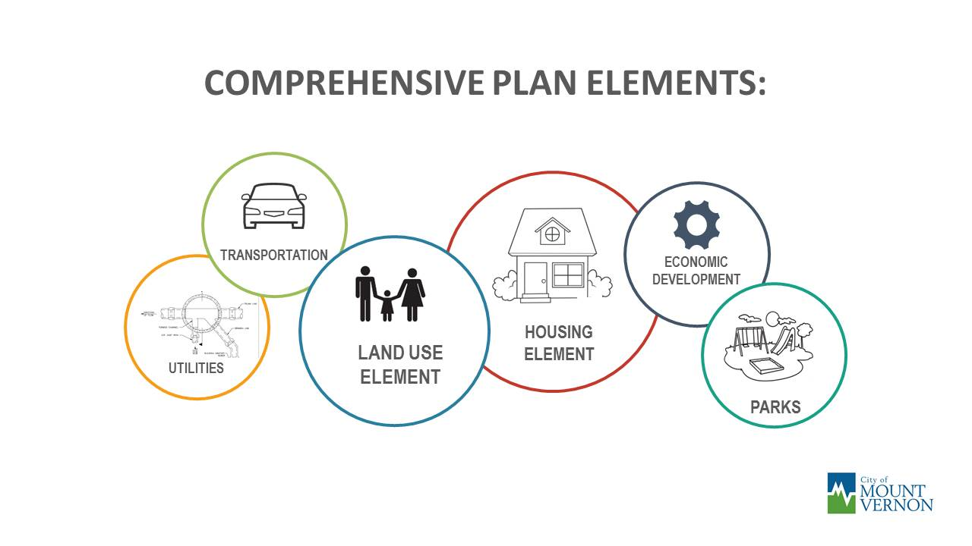


What is Included?
HEALTH
& WELLNESS
& SERVICES
ENVIORNMENT
& CLIMATE
Updated every 10 years
Covers 20-year period - 2025 to 2045
Notes:
Land Use
Do we have the right amount and type of land to support the homes, jobs, and services our community needs—now and in the future?
Housing –
How can we provide housing options that work for everyone, no matter their income?
Economic Development
How can we attract and retain businesses?
Transportation –
Will our roads support this many new vehicles?
Are our walking and biking routes safe, comfortable, and usable for everyone?
Utilities and Services
Do we have capacity in our utilities? Can we provide police and fire services?
Parks
Do we have enough land for parks?
Climate and Environment
How can we protect our natural environment and prepare for climate change in ways that support a healthy, resilient, and thriving community?
Health and Wellness
How can we design our community to support the health, well-being, and quality of life for all residents?

Slide 4
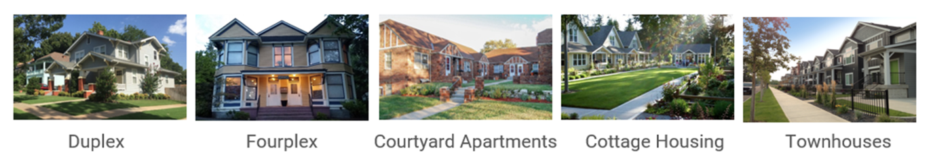
Housing Changes
Parking Standards
Reducing parking minimums
Establishing maximums
Developing shared parking schemes

Slide 5


Listening Session Topic #1
Gains and Pains
GAINS NOW
GAINS FUTURE
What works well right now?
What is important to maintain?
What are your aspirations for what the City could be in 20 years?
What do you want to see happen as the City develops and grows?
NOW
FUTURE
PAINS NOW
PAINS FUTURE
What does not well right now?
What existing issues need fixing?
What concerns do you have about the City 20 years from now?
What potential future issues need to be addressed?
Add details here
Add details here
Notes:
Think about the future growth of Mount Vernon by the year 2045.
What are your aspirations for what the City looks like in 30 years? What are your concerns about how the City grows over this time?
In this exercise, you will be asked to brainstorm what you want to see happen in the future growth of the City -- we will call these “Gains”. You will then be asked to brainstorm things that concern you about this growth and that need to be addressed -- we will call these “Pains”.

Slide 6



Listening Session Topic #2
Welcoming and Inclusive Mount Vernon
 | What helps you feel welcome, safe, and included in your neighborhood?
 | What helps you get around town and take part in community events or activities?
 | What changes would make our spaces better for everyone to enjoy and feel proud of?

Slide 7
What’s Next?
Housing Accelerator
State-mandated changes to housing regulations
Other Elements
Climate
Final Adoption
Public hearings: Late 2026
Public hearings: Late-2025 – early-2026
Transportation
Health and Wellness
Future Listening sessions in 2026

